Slide 1

Policies of the Ministry of Education and Research regarding Ukrainian refugee children enrolled in educational institutions
(Results of 2025)

Slide 2
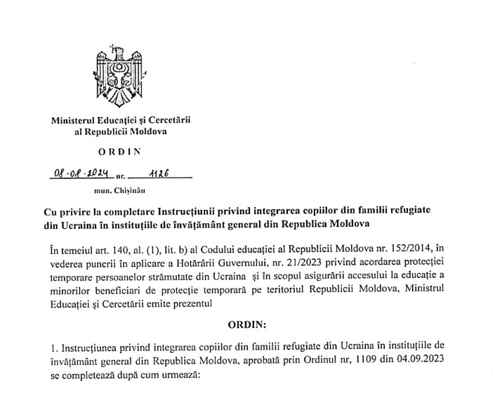
Instruction on the integration of children from refugee families from Ukraine and other countries affected by armed conflict into general education institutions in the Republic of Moldova
(latest amendment approved by Order of the Minister of Education and Research No. 1126 of
08 August 2024)

Slide 3
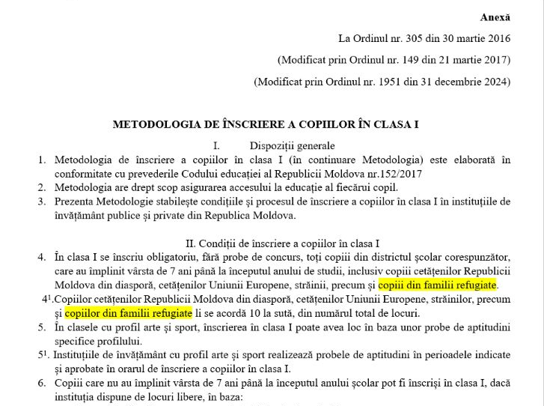
Methodology for the enrollment of children in the 1st grade(approved by Order of the Ministry of Education and Research No. 1951 of 31 December 2024)

Slide 4

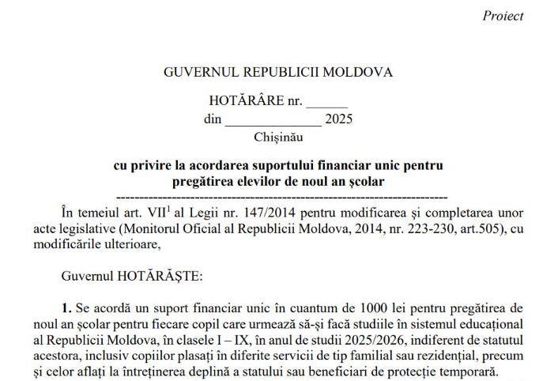
One-time financial assistance in the amount of 1.000 lei, including for children benefiting from temporary protection
(provided during the period September–December 2025)

Slide 5
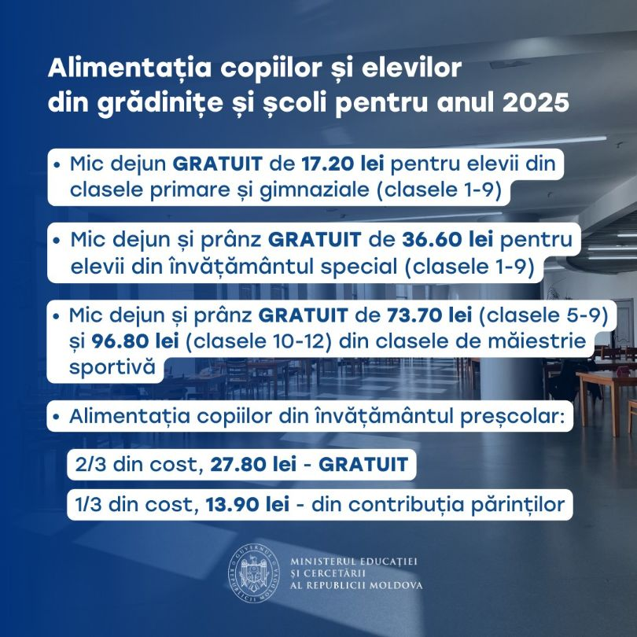
Free breakfast, including for refugee children studying in educational institutions in the Republic of Moldova

Slide 6
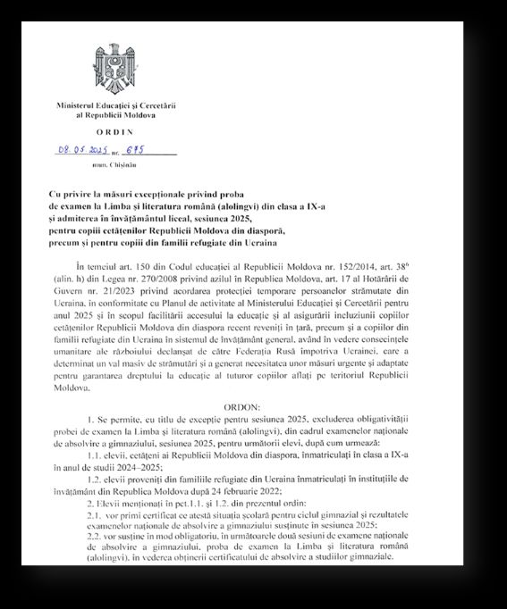
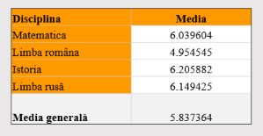
Exceptional measures regarding the Romanian language and literature examination for Grade IX in the 2025 session and subsequent admission to upper secondary education (lyceum)
(approved by Order No. 675 of 08 May 2025)
Overview of examination results for Ukrainian refugee students enrolled in formal education (9th grade)

Slide 7
Number of refugee children from Ukraine enrolled in schools (by language of instruction and by grade)
(December 2025)
încadrați în școli | cl.1 | cl.2 | cl.3 | cl.4 | cl.5 | cl.6 | cl.7 | cl.8 | cl.9 | cl.10 | cl.11 | cl.12 | Total | % din numărul total
l. română | 86 | 55 | 37 | 31 | 72 | 41 | 67 | 44 | 23 | 5 | 3 | 2 | 466 | 16.23
l. rusă | 300 | 275 | 306 | 249 | 215 | 241 | 240 | 243 | 180 | 84 | 53 | 19 | 2405 | 83.77
Total | 386 | 330 | 343 | 280 | 287 | 282 | 307 | 287 | 203 | 89 | 56 | 21 | 2871

Slide 8
Number of refugee children from Ukraine enrolled in early childhood education institutions (December 2025)
încadrați în IET | până la 2 ani | 2 ani | 3 ani | 4 ani | 5 ani | 6 ani | 7 ani | Total, copii | % din numărul total
fete | 2 | 1 | 69 | 99 | 93 | 103 | 11 | 378 | 46.78
băieți | 2 | 23 | 75 | 115 | 113 | 89 | 13 | 430 | 53.22
Total | 4 | 24 | 144 | 214 | 206 | 192 | 24 | 808

Slide 9
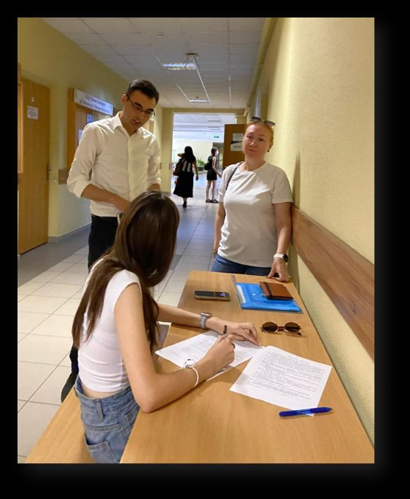
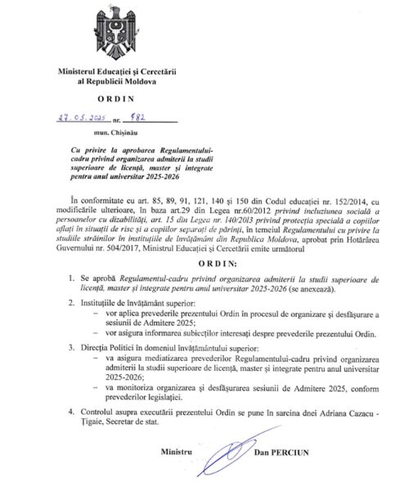
Admission of Ukrainian citizens to bachelor’s and master’s degree higher education institutions on state-funded places and alignment of tuition fees with the level established for citizens of the Republic of Moldova
(approved by Order No. 782 of 27 May 2025)

Slide 10
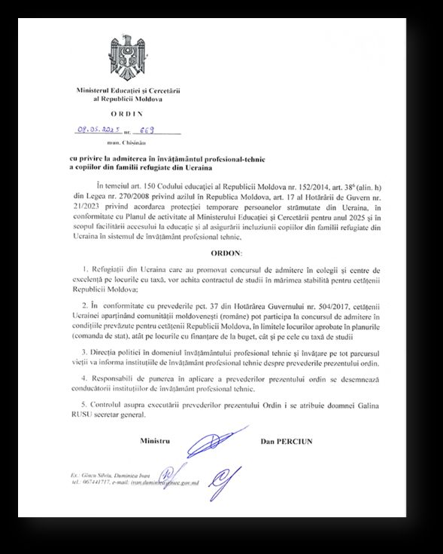
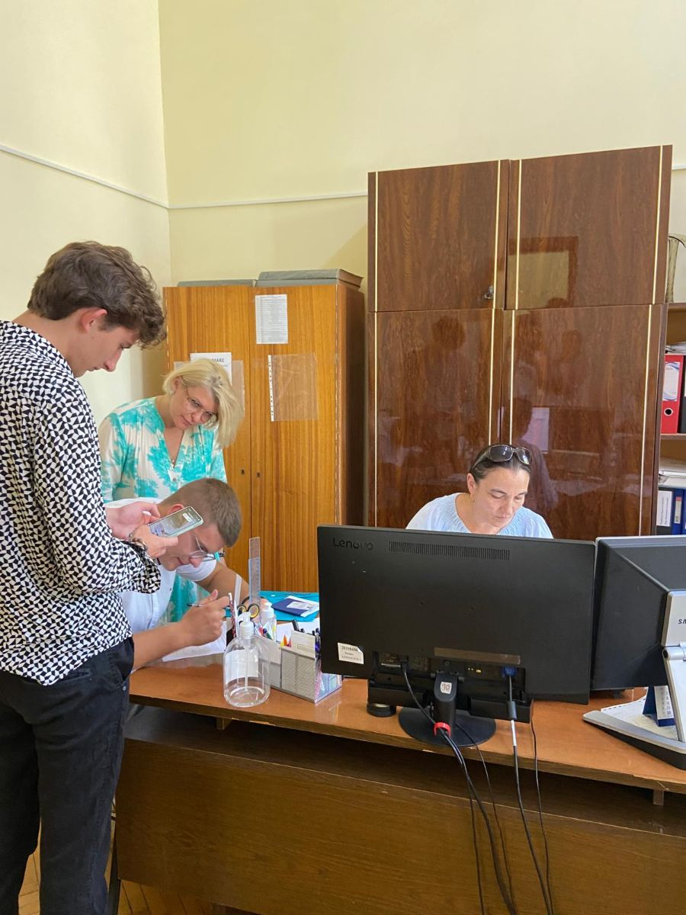
Admission of refugee children from Ukraine to vocational and technical education(approved by Order No. 669 of 08 May 2025)

Slide 11
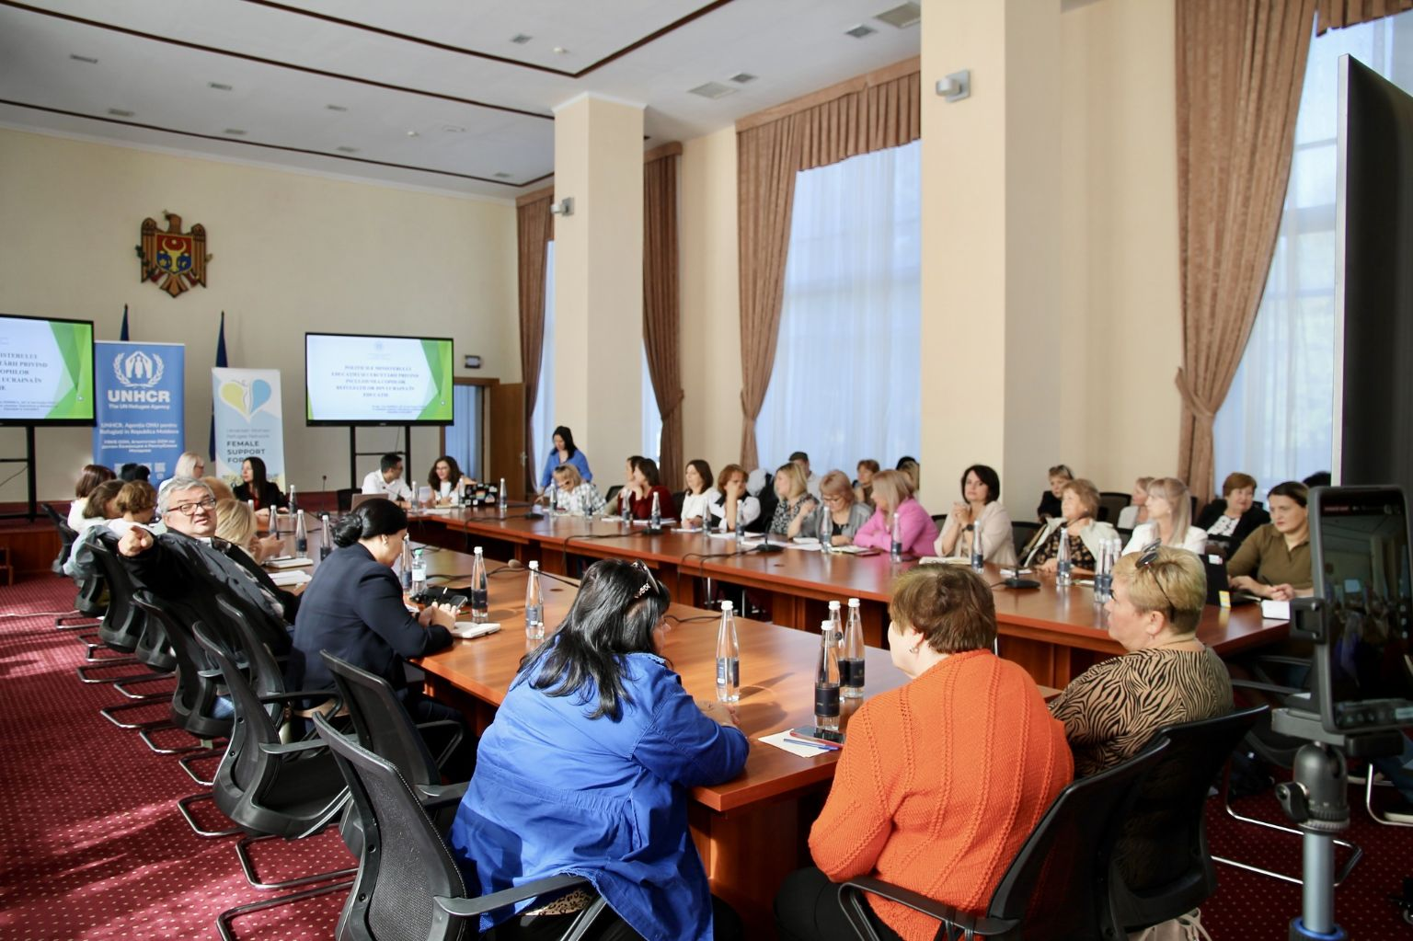
Two information sessions for parents of refugees from Ukraine on admission to vocational and technical, and higher education
(July-August 2025).
Organized by: the Ministry of Education and Research, in partnership with UNHCR Moldova and Female Support Force

Slide 12
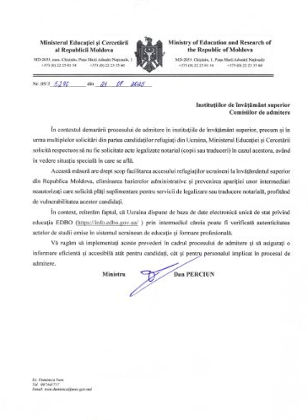
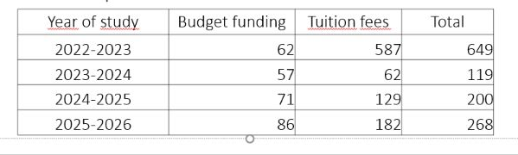
Elimination of the requirement for notarized legalization of documents submitted by refugee candidates from Ukraine in the admission process to higher education and vocational and technical education
(MER Circulars No. 05/3-5246 and No. 05/3-5273 of 21 July 2025)
Admission to higher education

Slide 13
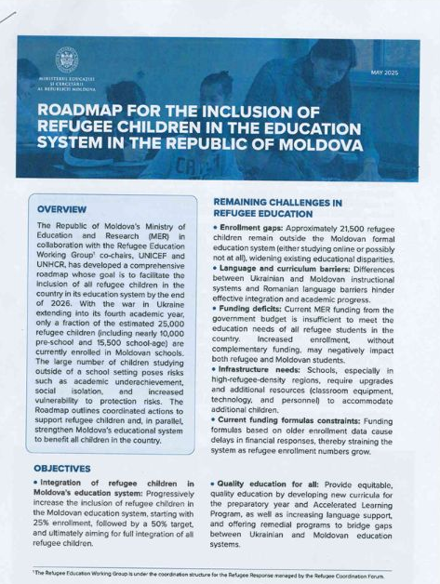
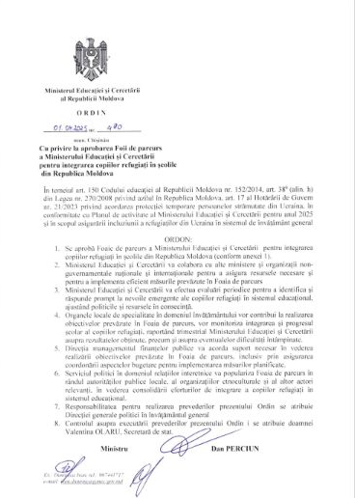
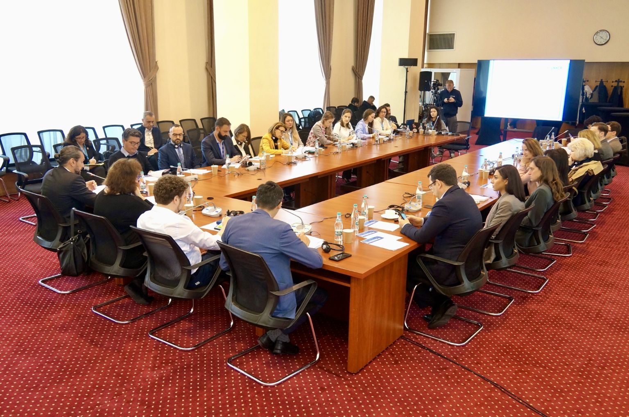
Roadmap of the Ministry of Education and Research for 2025–2026 on the integration of refugee children into schools in the Republic of Moldova
(approved by Order No. 490 of 01 April 2025)

Slide 14
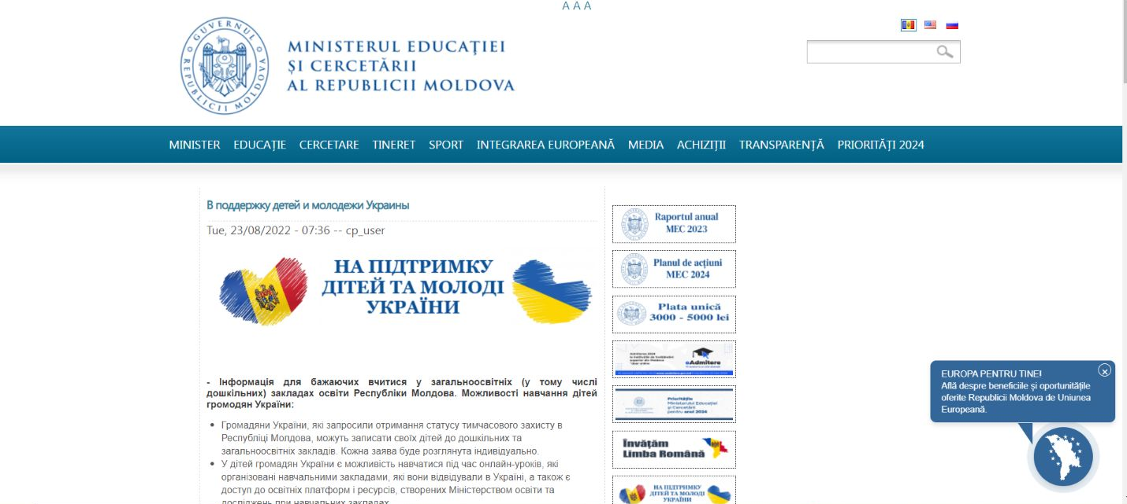
Webpage of the Ministry of Education and Research dedicated to refugees from Ukraine

Slide 15
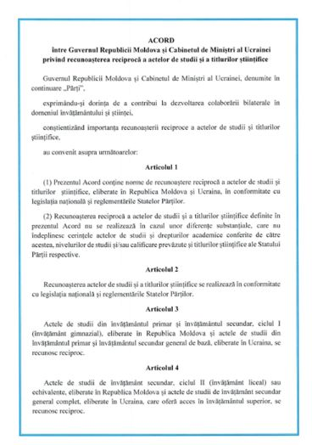
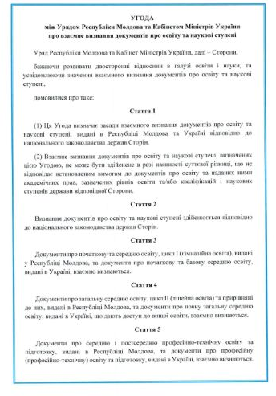
Agreement on the mutual recognition of education documents between the Republic of Moldova and Ukraine
(approved by the Government of the Republic of Moldova on 5 March 2025)

Slide 16
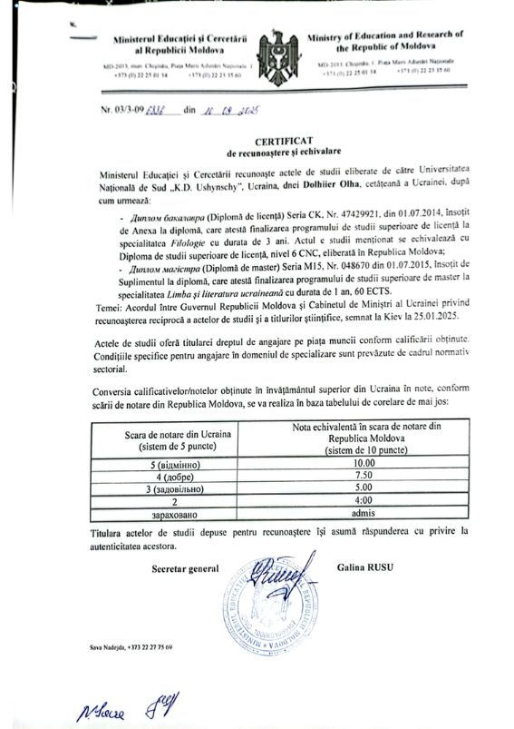
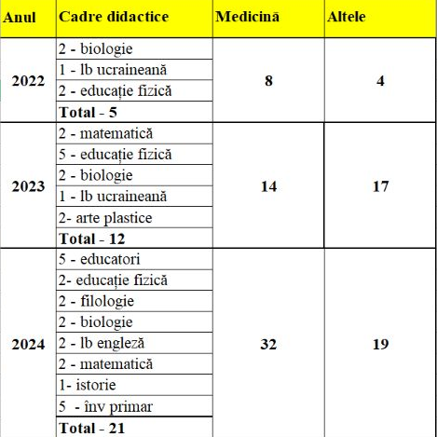
Certificates of recognition and equivalence of education documents issued by the Ministry of Education and Research to teachers who are refugees from Ukraine
Cate sa-u achivalat in 2025

Slide 17
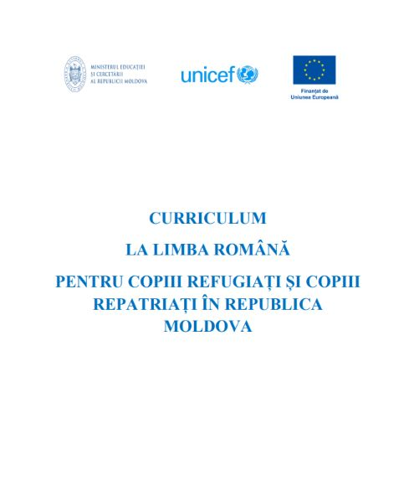
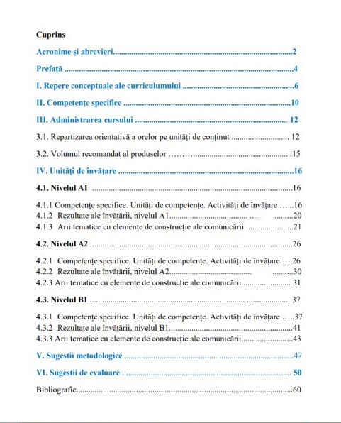
“Romanian Language Curriculum for Refugee and Repatriated Children in the Republic of Moldova”
(approved by the Ministry of Education and Research on 27 October 2025)

Slide 18
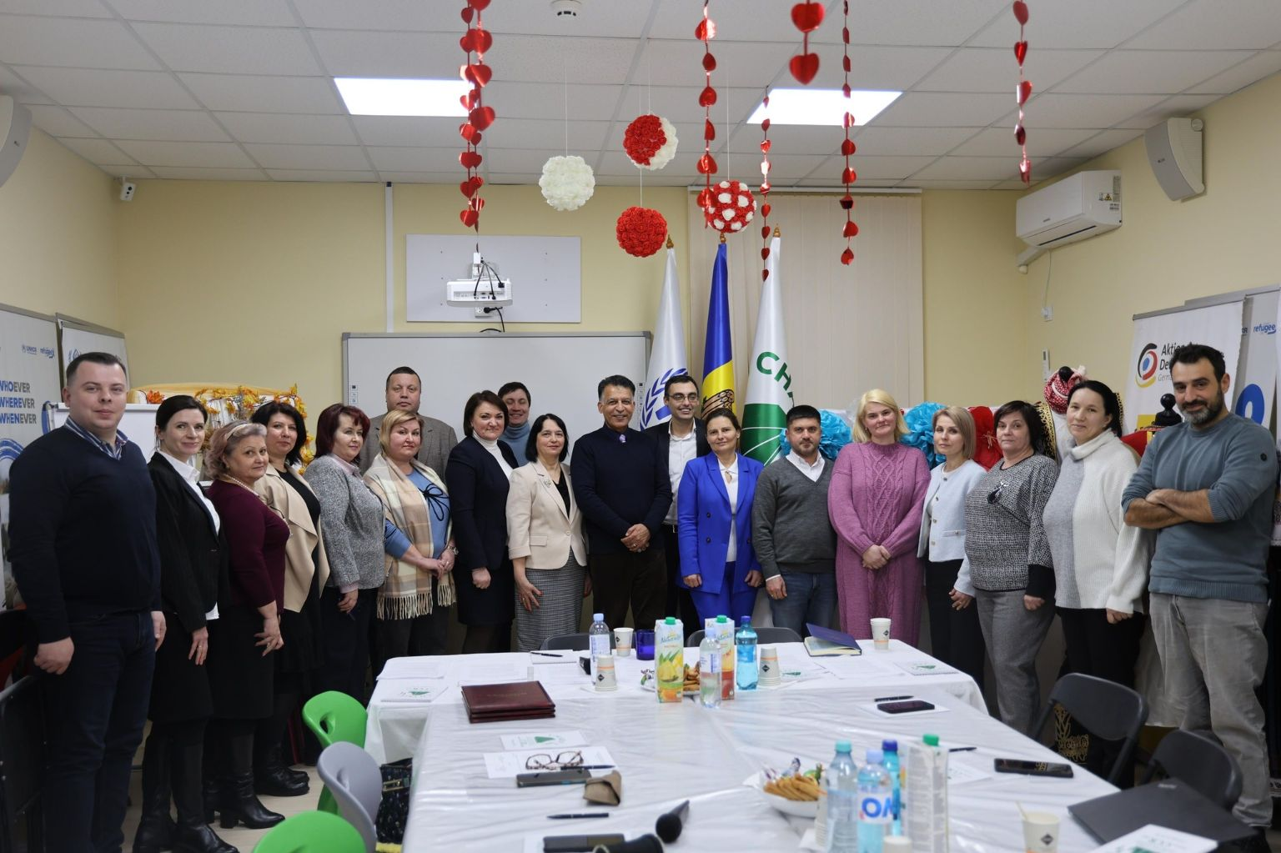
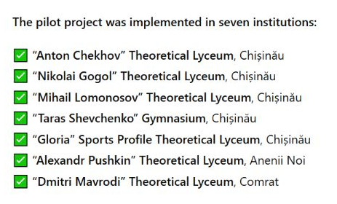
Opening of Romanian language courses for refugees from Ukraineю
Project implemented by: Charity Centre for Refugees.
With support from: UNICEF Moldovaand Ministry of Education and Research

Slide 19
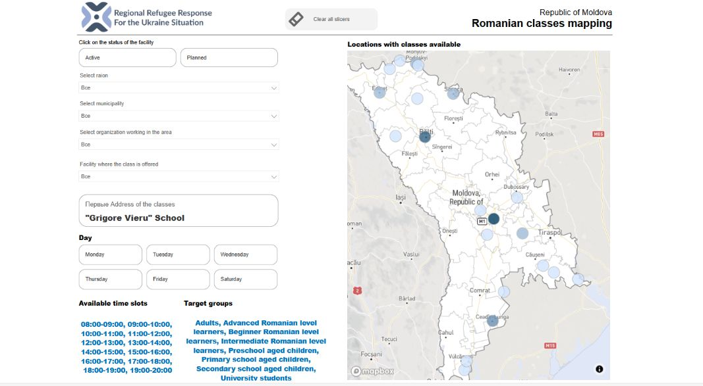
Online map of Romanian language learning centers

Slide 20
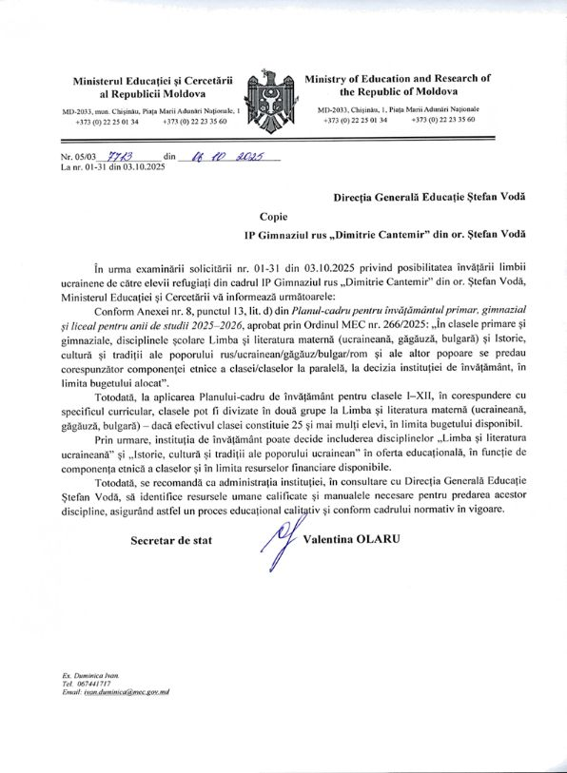
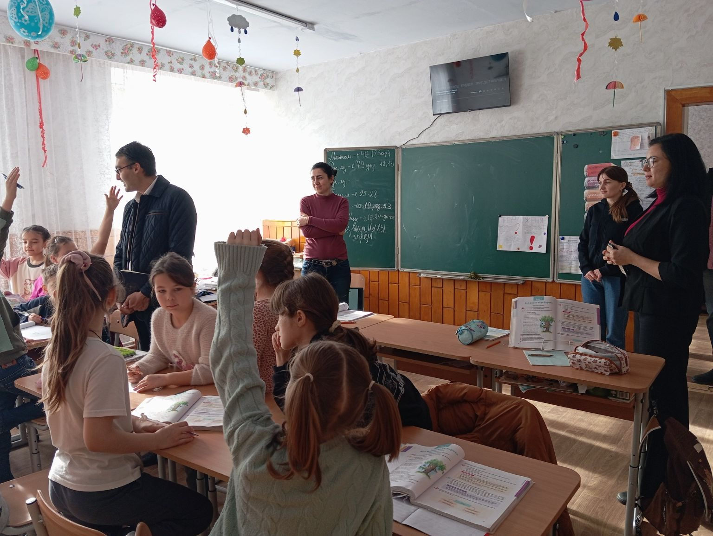
Ukrainian language club for refugee pupils at the
“Dimitrie Cantemir” Gymnasium in Stefan Voda
(opened in October 2025)

Slide 21

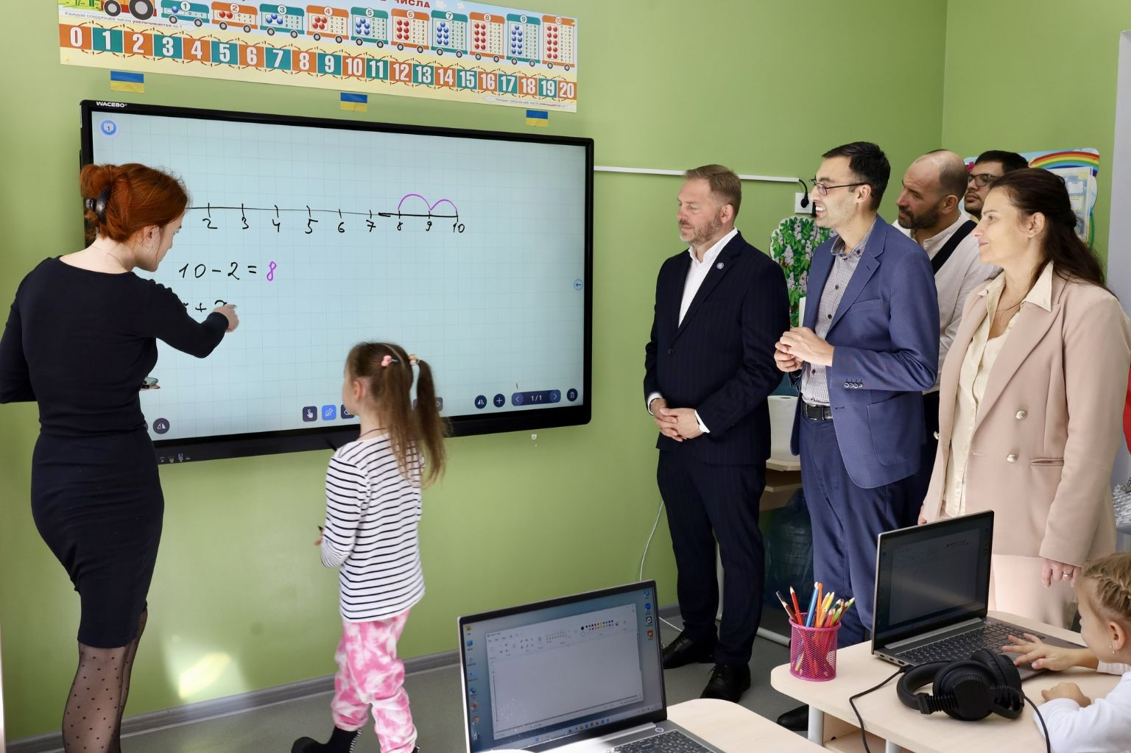
Fully renovated and equipped classrooms at the
“Taras Shevchenko” Gymnasium in Chisinau

Slide 22
Classes with instruction in the Ukrainian language at the “Taras Shevchenko” Gymnasium in the Municipality of Chisinau
(Academic year 2025/2026)
Classes | Number of children
I | 34
II | 29
III | 11
V A | 25
V B | 22
VI | 18
VII | 28
VIII | 13
In total | 180

Slide 23
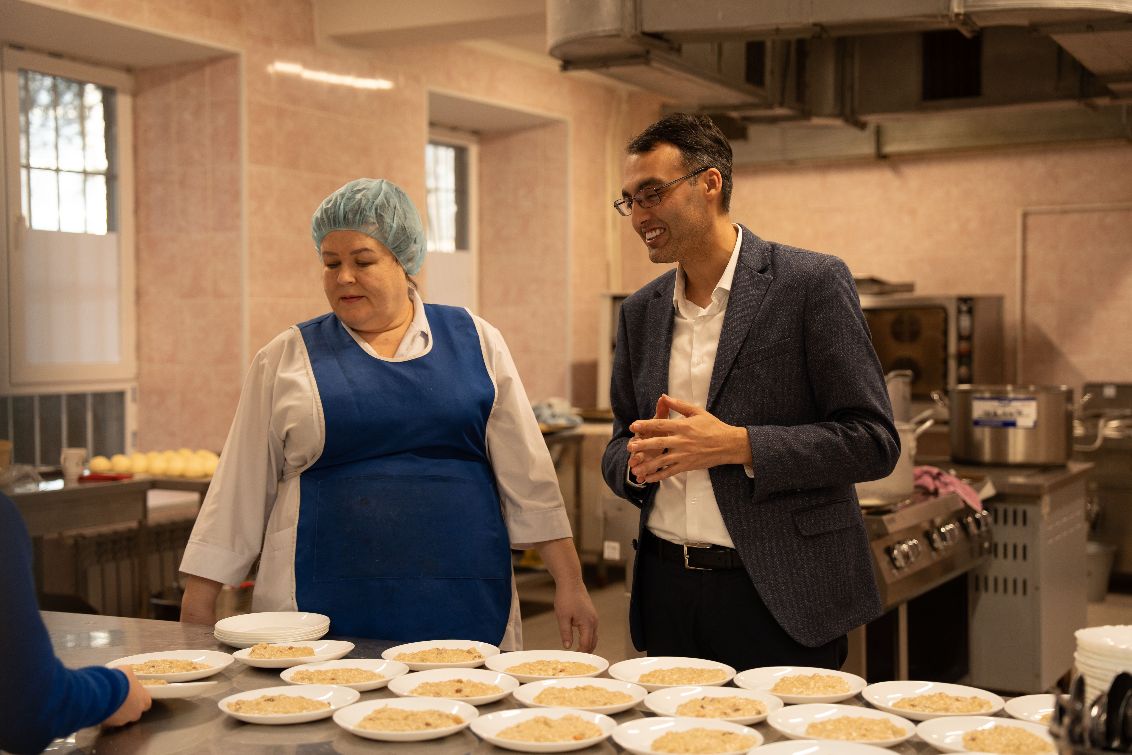
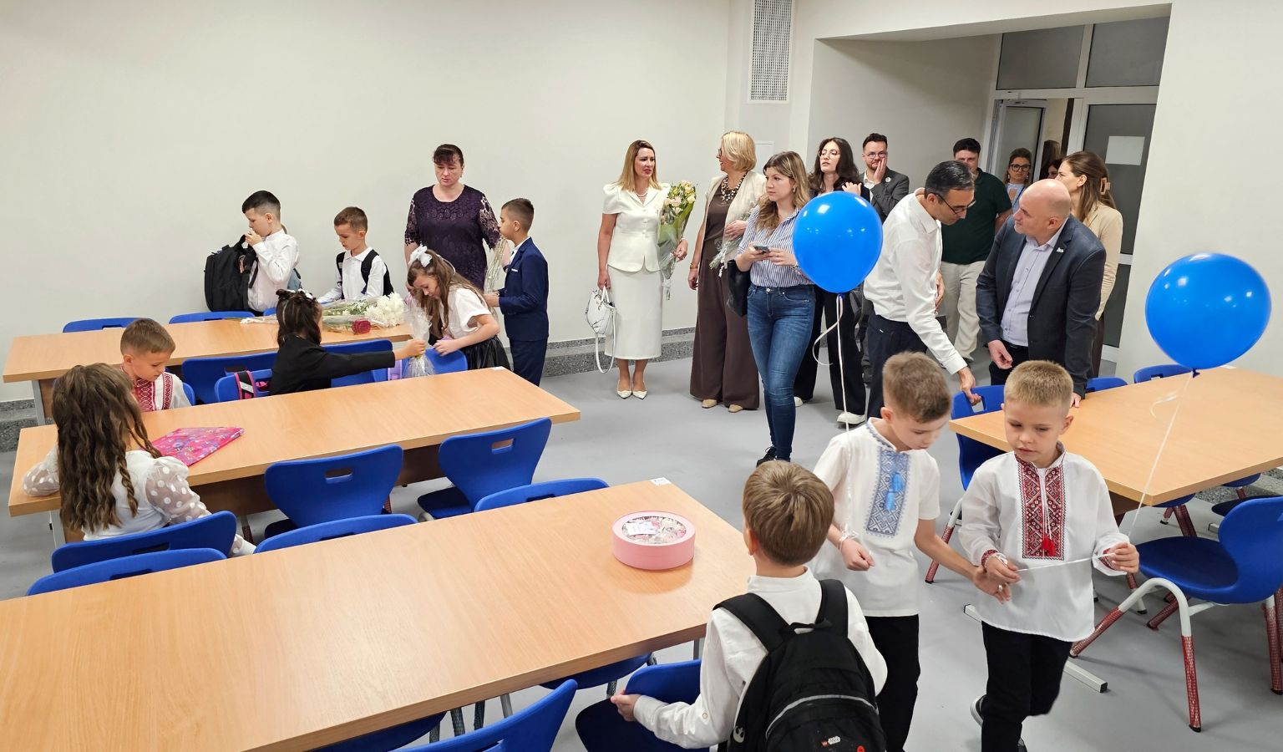
Renovated and equipped canteen at the Taras Shevchenko Gymnasium(reopened on 1 September 2025).
Partner: People in Need

Slide 24
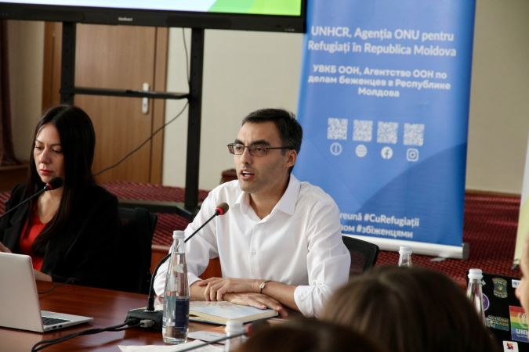

The practice of direct communication between officials of the Ministry of Education and Research and parents of refugees from Ukraine (26 August 2025).

Slide 25
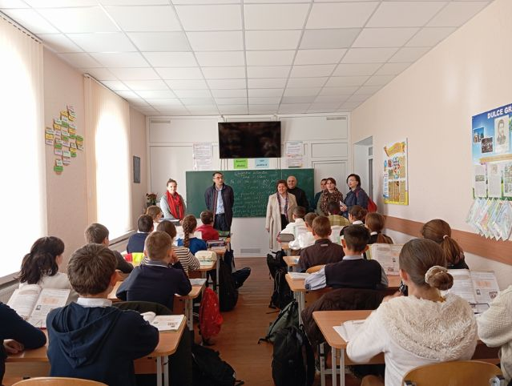
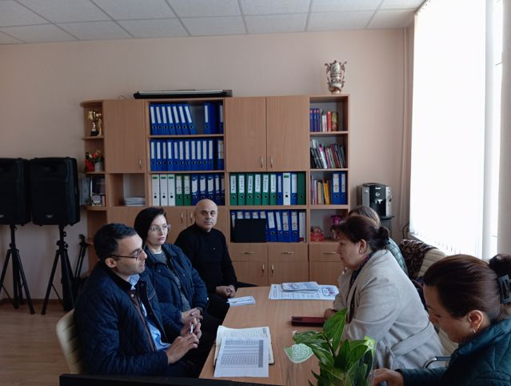
Working visit of the Education Group for Ukrainian Refugees to Basarabeasca
(14 October 2025)

Slide 26
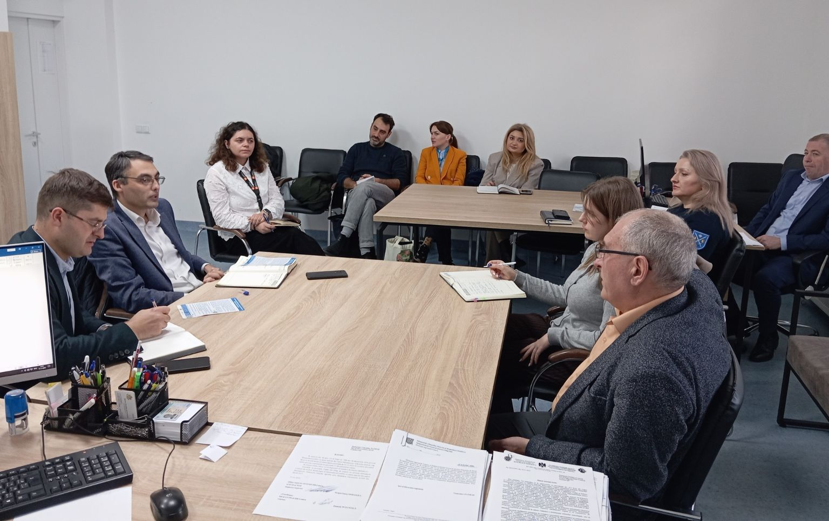
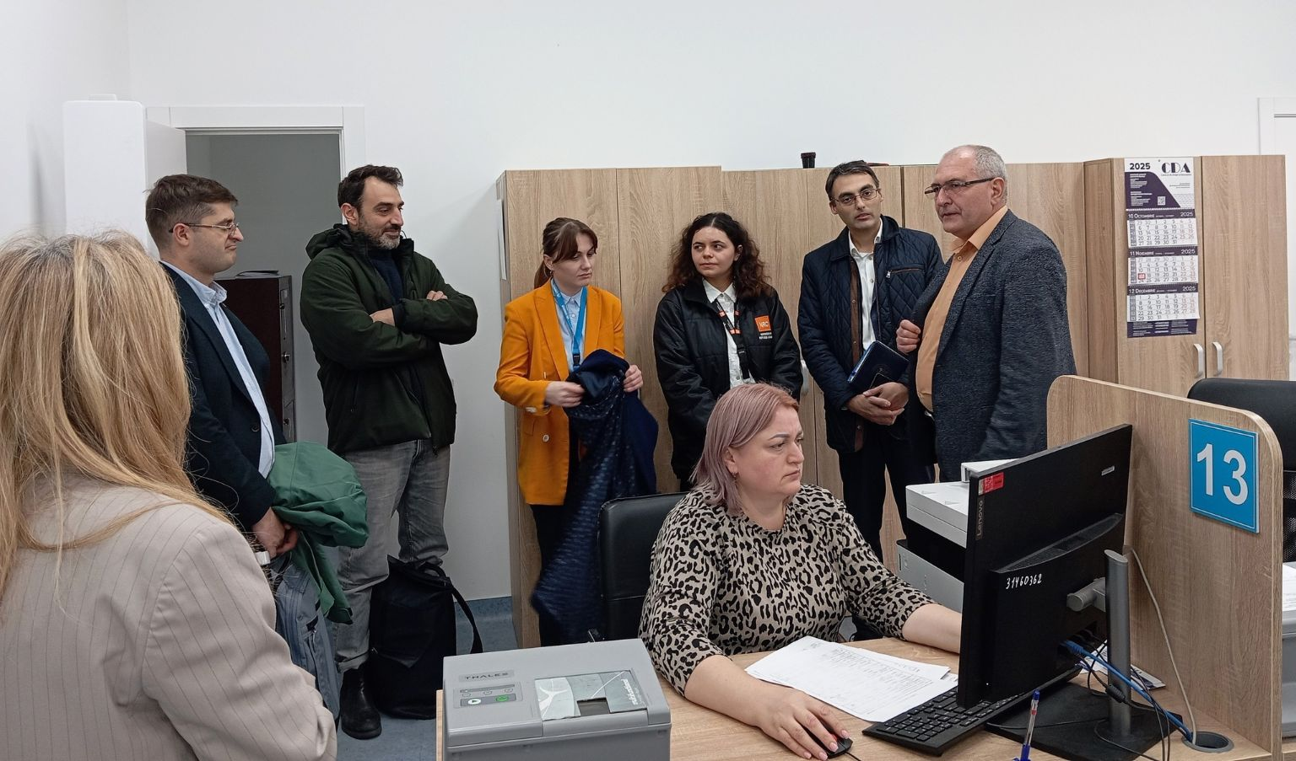
Joint meeting of representatives of the Ministry of Education and Research and the General Inspectorate for Migration of the Ministry of Internal Affairs(21 November 2025)

Slide 27
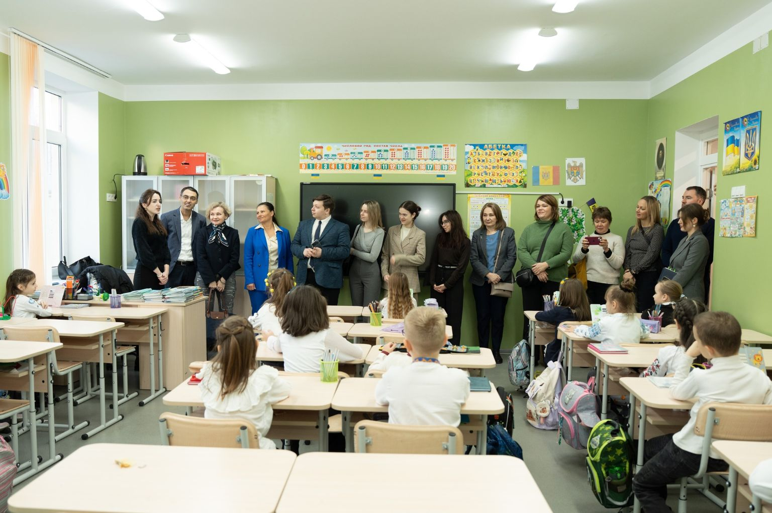
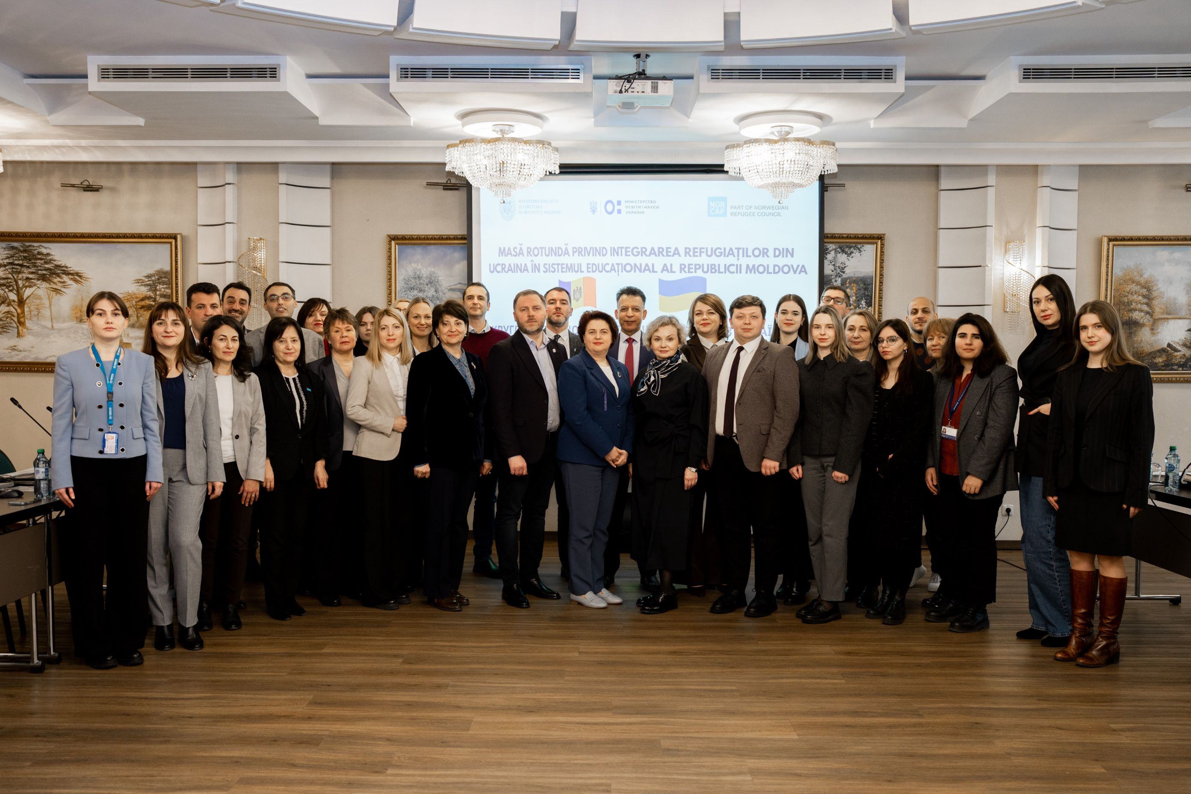
The Ministry of Education and Research of the Republic of Moldova, with the support of NORCAP, organized a working meeting in Chisinau with representatives of the Ministry of Education and Science of Ukraine(18–19 December 2025)

Slide 28
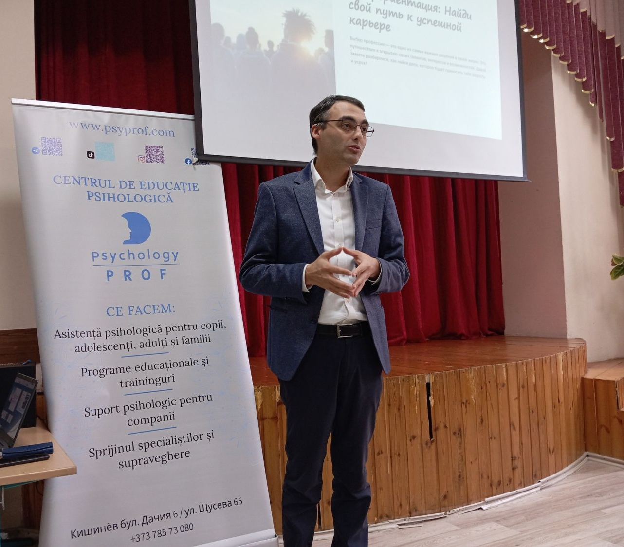
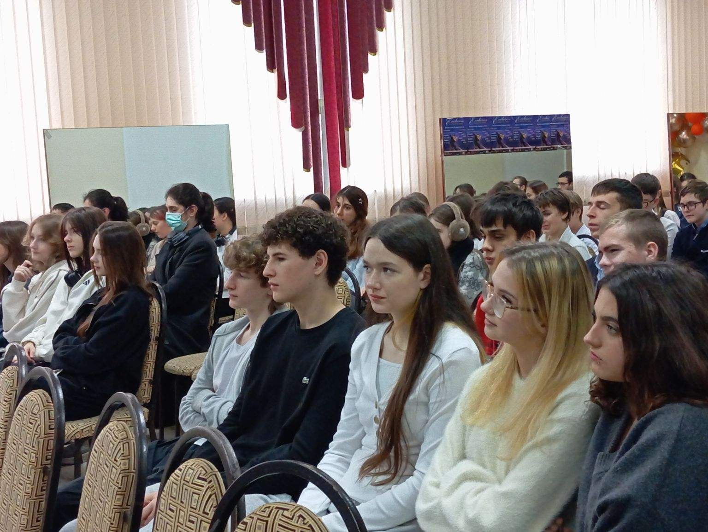
Training session on career guidance at the “Mihailo Kotsiubynskyi” Theoretical Lyceum in Chișinău(27 November 2025).
Partner: Moldovan Association of Gestalt Therapy and Psychodrama

Slide 29
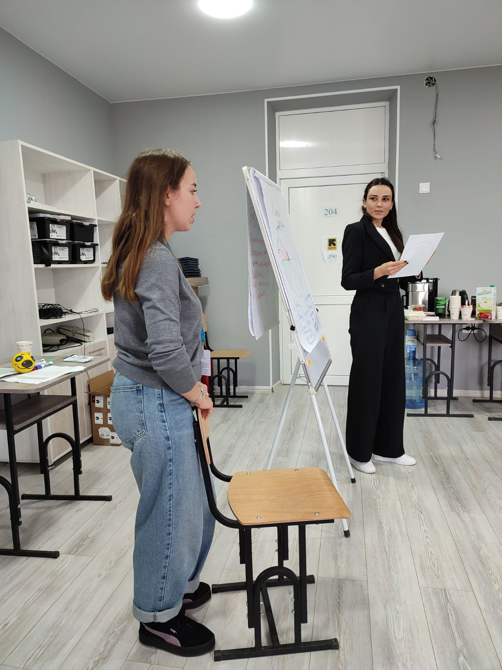
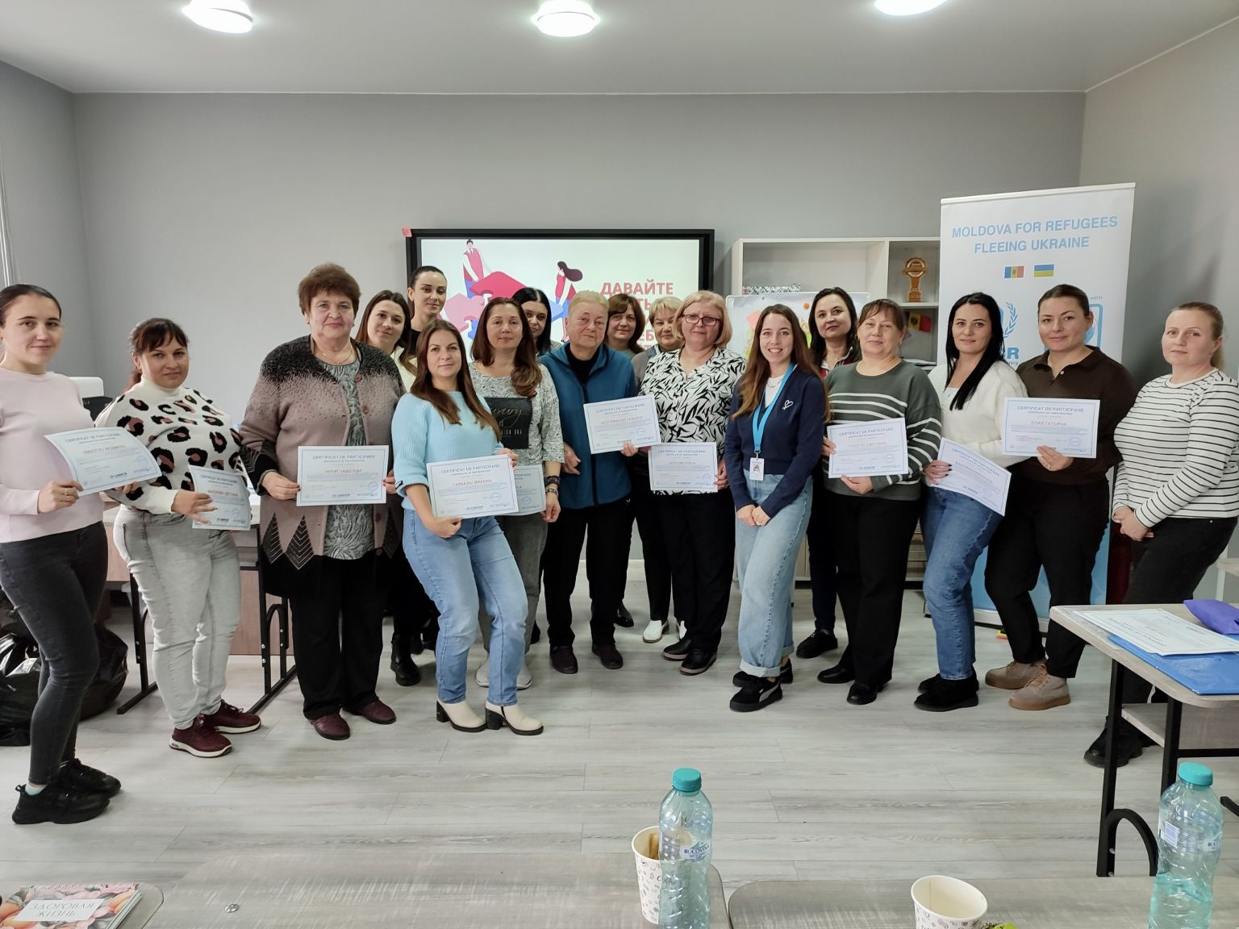
Series of workshops on promoting well-being and psychological welfare of teachers working with refugee children(20 October – 7 November 2025). Partners: Intersos Moldova and UNHCR Moldova

Slide 30
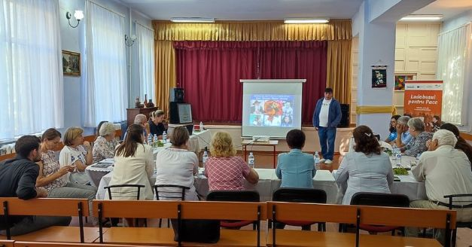
Series of information sessionsfor teachers on how to work with Roma refugees from Ukraine.
Organized by: the Roma Youth Union “Tarna Rom”.
With the support of: UNHCR Moldova, UNICEF Moldova, and the Ministry of Education and Research

Slide 31
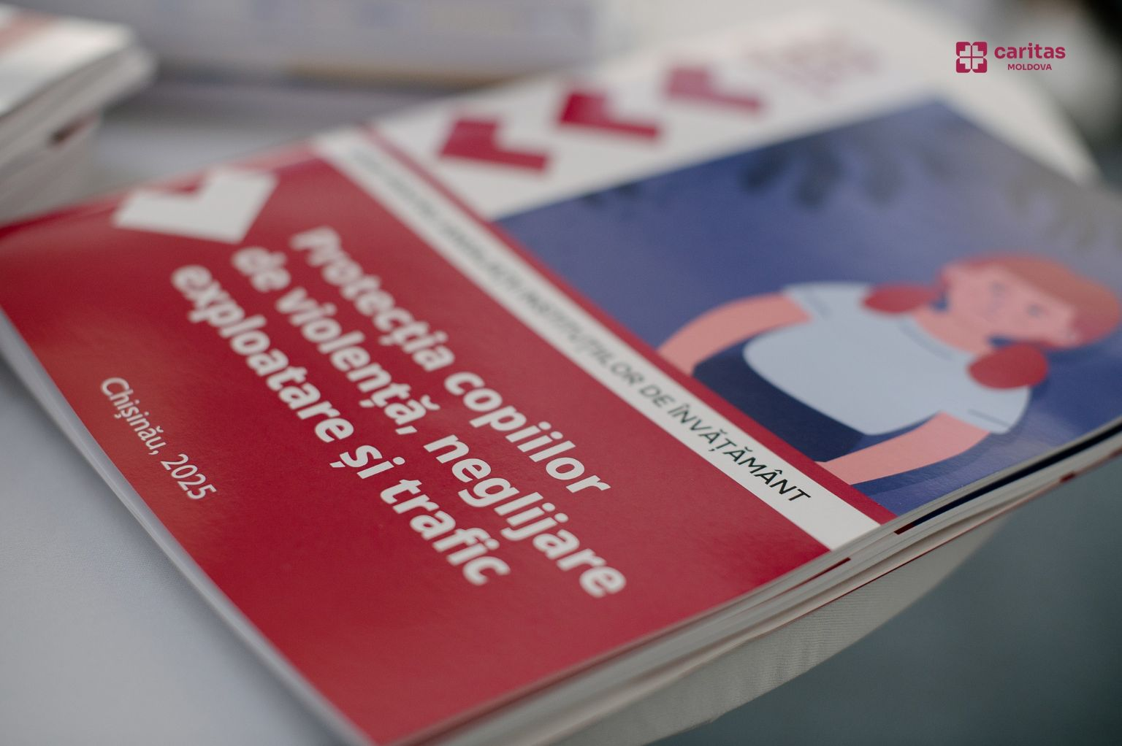
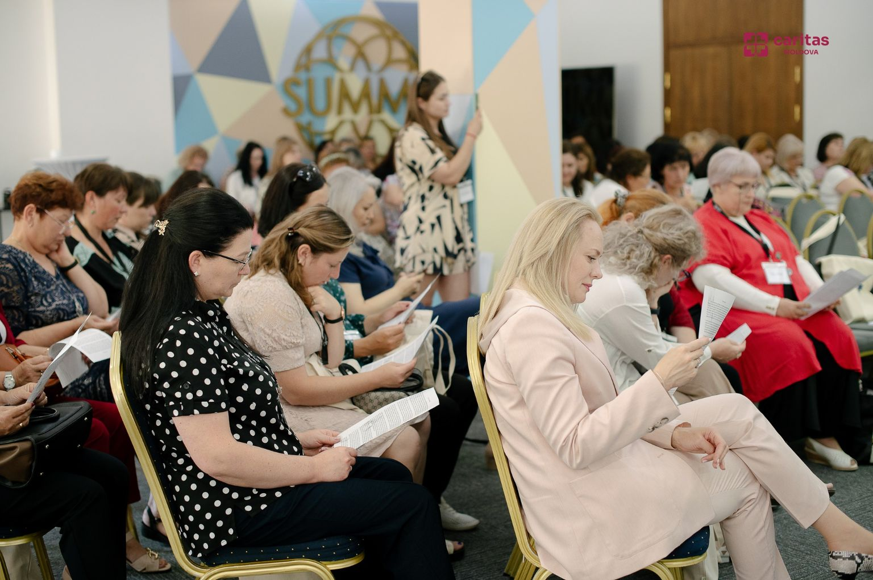
The SMART project aimed to improve the quality of assistance provided to children affected by crises, in particular refugees from Ukraine, as well as children from host communities.
Implemented by: Caritas Moldova. With the support of: the Ministry of Education and Research

Slide 32
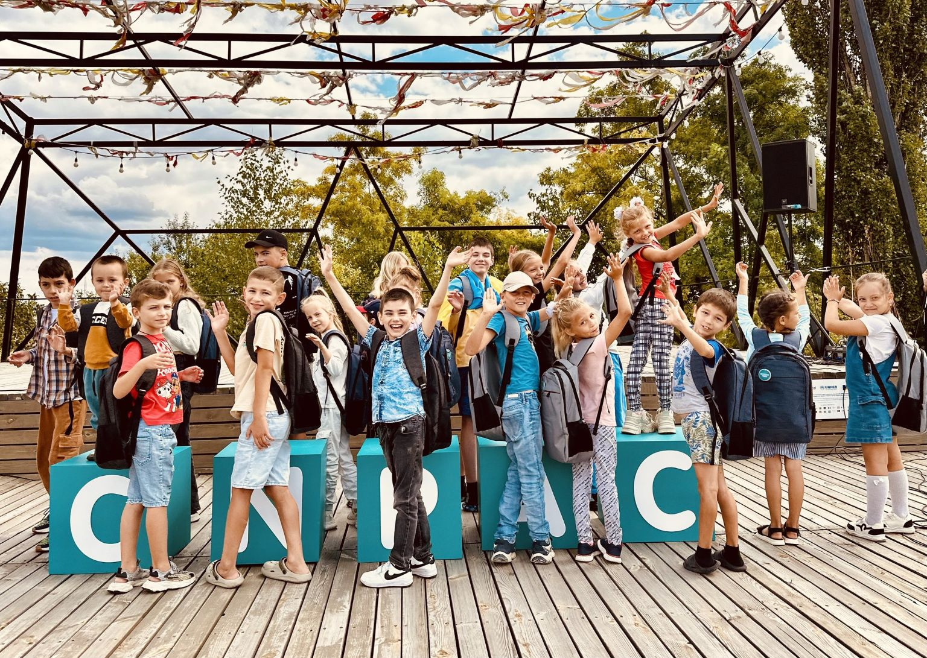

Project “Together for Education: Empowering Displaced Families in Moldova”
Implemented by the National Center for the Prevention of Child Abuse (CNPAC), in partnership with the Norwegian Refugee Council (NRC), with the support of the Ministry of Education and Research (MER)

